Slide 1
Welspun Corp Limited
CSR Projects Approved by the Board for
FY 2022-23

Slide 2
OUR PHILOSOPHY
Welspun’s corporate philosophy has always been to practice ethical business and be socially responsible. There is a strong commitment to a wider all-round social progress, as well as to a sustainable development that balances the needs of the present with those of the future.
Welspun Group’s social vision has been enshrined in the three E’s which have become the Guiding Principles of our CSR initiatives :–
Education,
Empowerment and
Environment & Health.
We shall endeavor to undertake our projects under the banner of the Welspun Foundation for Health and Knowledge (WFHK) that aim towards holistic development of the villages around our plant and project locations.

Slide 3
LIST OF PROJECTS APPROVED BY THE BOARD OF WELSPUN CORP LIMITED FOR THE FINANCIAL YEAR 2021-22.
------------------------------------------------------------------------------------------------------
Education
  1.1 Wel- Shiksha
  1.2 Vidya Mandir and Public School
Environment
2.1 Wel-Netrutva – Livelihoods and Health
Environmental communities and plantation
Welspun Super Sport Women
We-Volunteer
Institutional Support
Spend on Covid-19

Slide 4

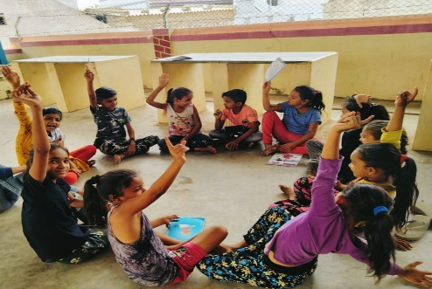
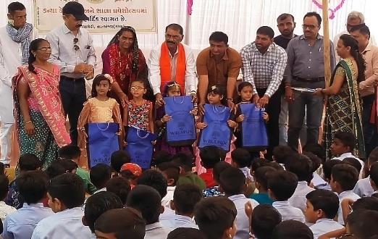
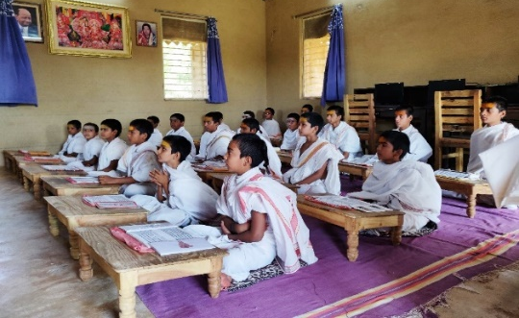
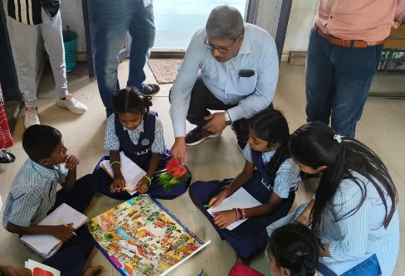
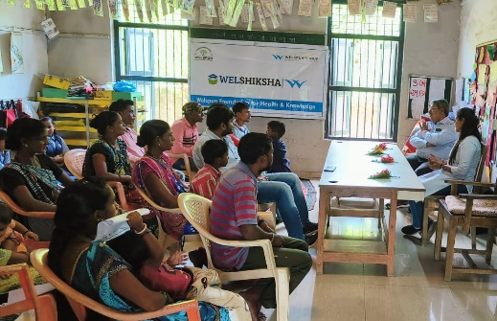
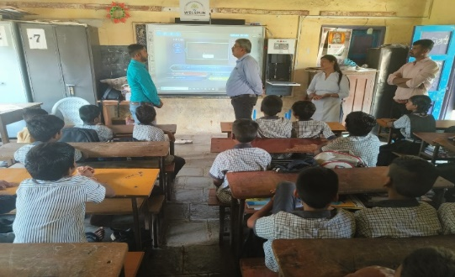
Objective: The project aims at improving learning levels outcome of students from government schools by merging the interventions of Digital Classroom, Shiksha Saathis (Para Teacher) and Teacher Trainings along with volunteers from the villages to promote education.
Locations: Anjar, Dahej, Jhagadia and Valsad.
Learning Levels Summer Camp
Shala Praveshutsav
Ved Vidyalaya
Learning Camp in School
Meeting with SMC Members
Digital Smart Classroom

Slide 5

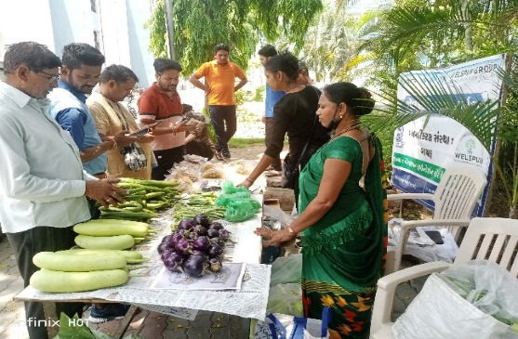
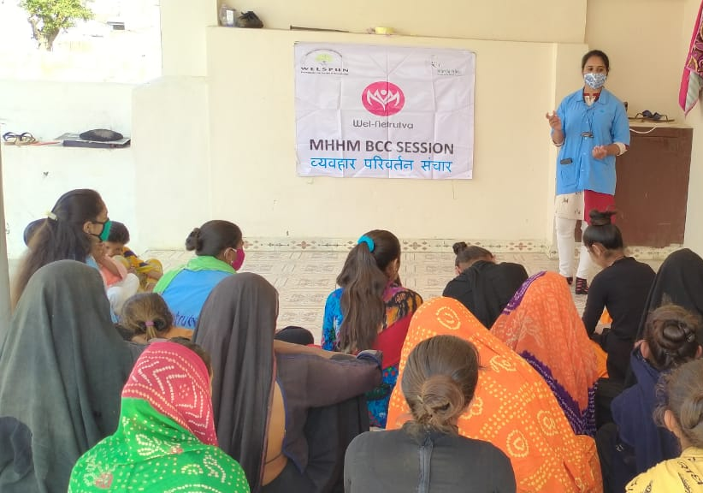
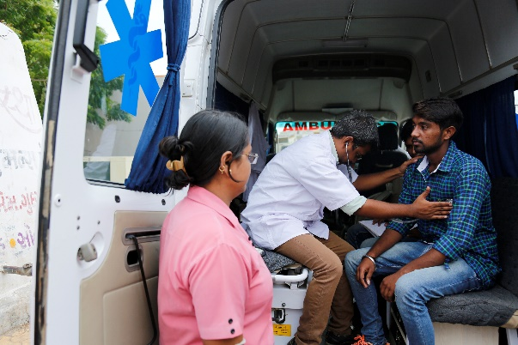
Objective: To empower women in rural areas by improving health practices and creating sustainable farm and non farm based livelihood opportunities.
About: Individual and Group Enterprises to create livelihood opportunities. The health aspect of the program focuses on improvement in preventive and curative health aspects of adolescent girls and women.
Locations: Anjar and Vapi.
Livelihood Opportunities
Improved Healthcare
Community Health

Slide 6
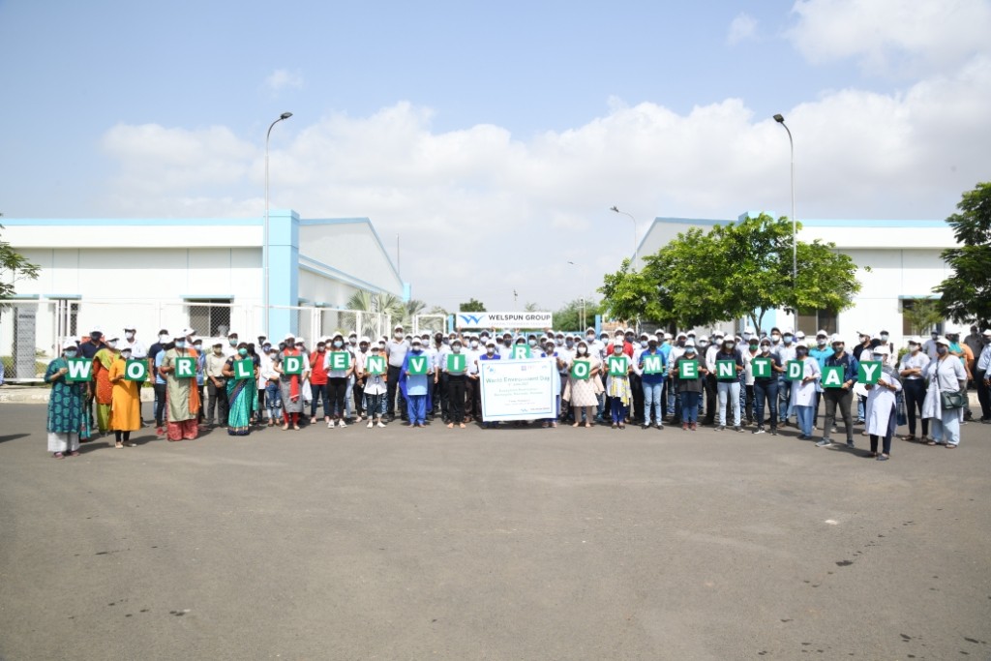
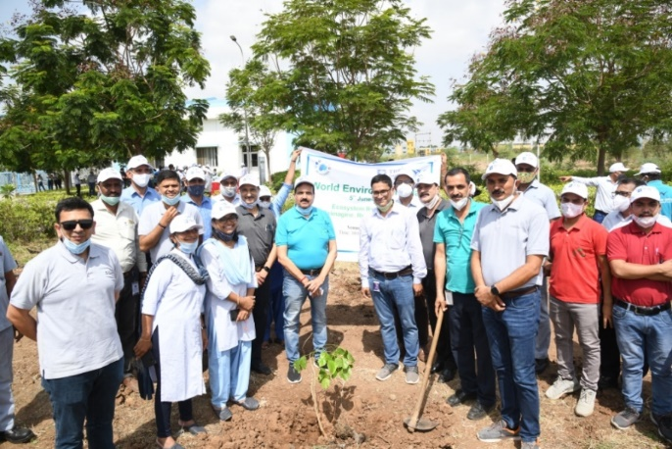
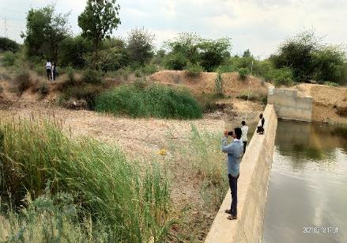
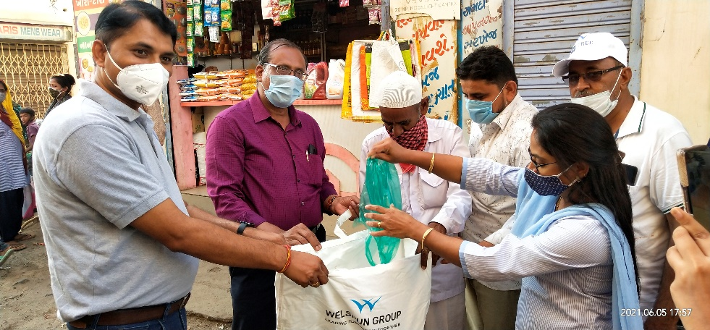
Environmental programs and Tree plantations

Slide 7

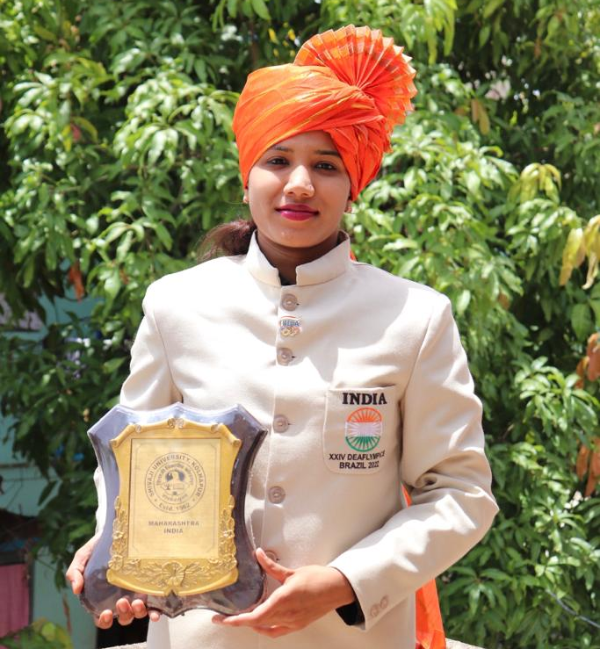
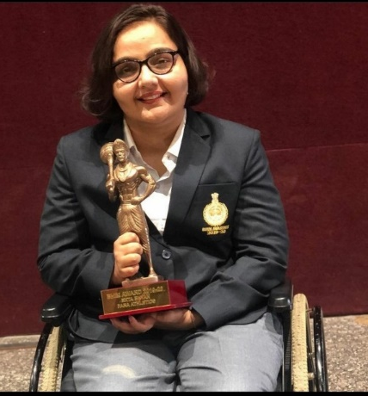
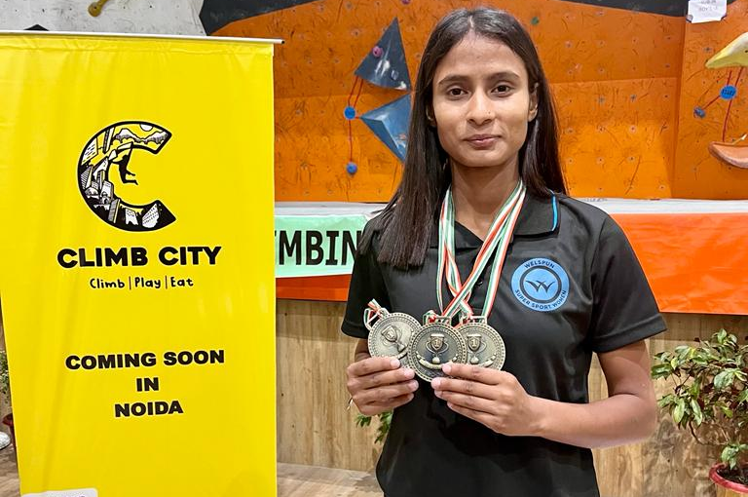
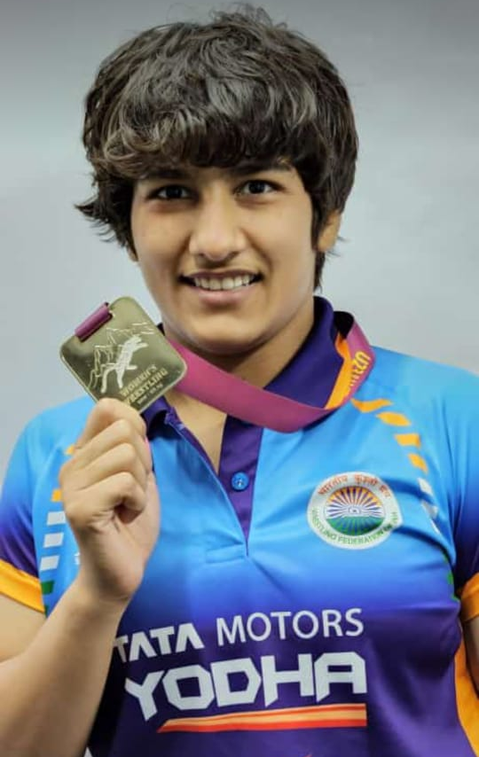
Welspun Super Sport Women
Objective: To empower female athletes coming from challenging backgrounds, in achieving their sporting endeavors and creating ambassadors of change.
Highlights
Subiya is the first D&M swimmer to represent India at the Deaflympics and achieved the 6th position.
Ekta Bhayan received “Bheem Award”, the highest sporting award of Haryana State.
Manasi Joshi Selected by World Economic Forum for their class of 2022 Young Global Leader.
Sr. No. | Particulars | Target 22-23 | Achieved 22-23
1 | Athletes | 40 | 29
2 | Medals | 150 | 48
3 | Featured Articles | 50 | 04
4 | Sport | 20 | 19

Slide 8

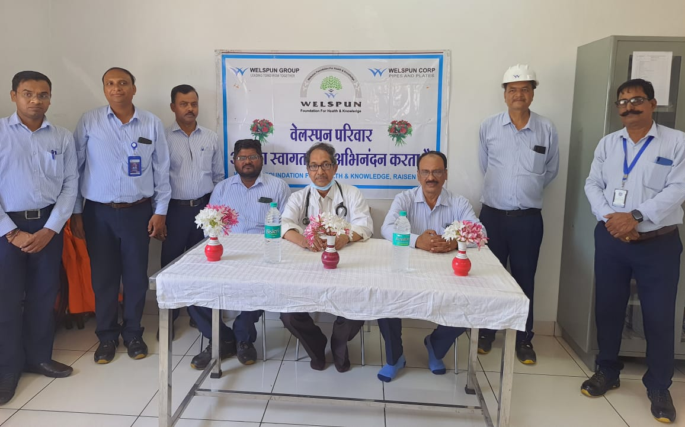
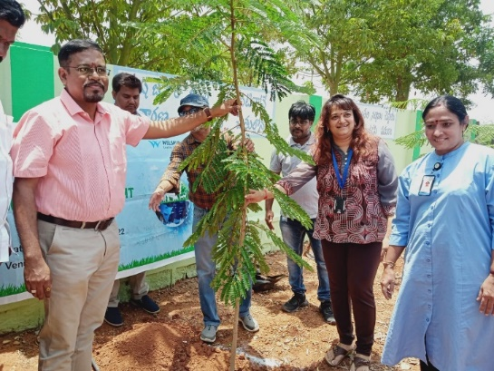
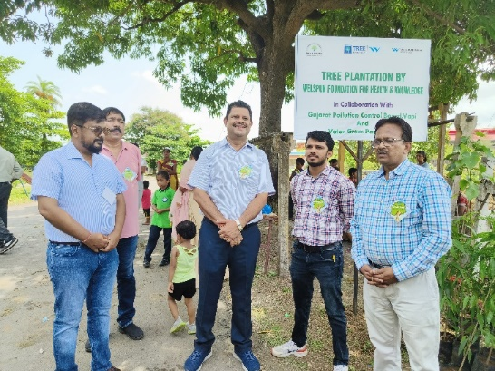
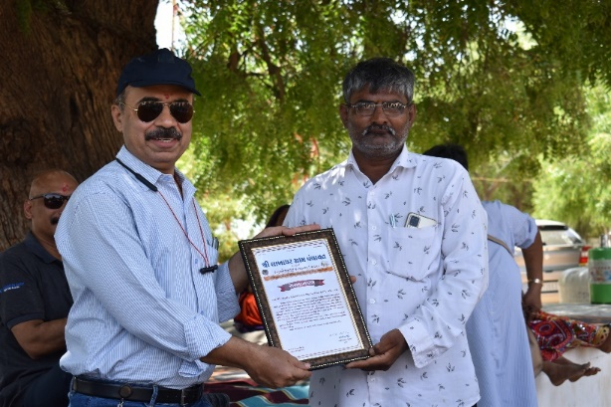
Employee Volunteering
Sr. No. | Particulars | Target 2022-23 | Achieved 2022-23
1 | Employee Participation | 3,000 | 709
2 | Volunteering Hours | 6,000 | 1,072

Slide 9
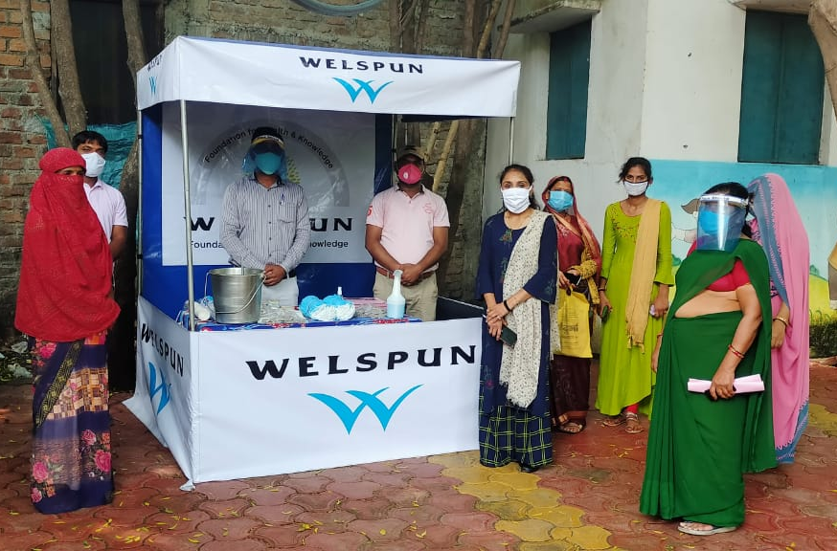
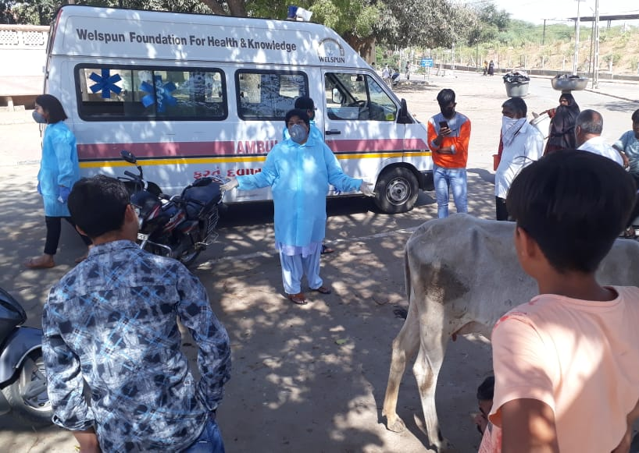
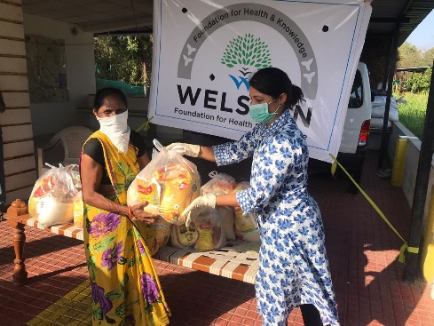
Covid-19 Relief Interventions
Sr. No. | Interventions
1 | Masks
3 | Ration Kits
4 | Ayurveda Tablets
5 | Kadha
6 | Hand Sanitizer Machines
7 | Oxygen Concentrators
8 | Antigen Kits
9 | ICU Ventilators
10 | Village Sanitization
11 | Awareness Drives
12 | Medical Equipment
13 | Oxygen Gas Plant
14 | Vaccinations

