Slide 1
Welspun Corp Limited
CSR Projects Approved by the Board for
FY 2021-22

Slide 2
OUR PHILOSOPHY
Welspun’s corporate philosophy has always been to practice ethical business and be socially responsible. There is a strong commitment to a wider all-round social progress, as well as to a sustainable development that balances the needs of the present with those of the future.
Welspun Group’s social vision has been enshrined in the three E’s which have become the Guiding Principles of our CSR initiatives :–
Education,
Empowerment and
Environment & Health.
We shall endeavor to undertake our projects under the banner of the Welspun Foundation for Health and Knowledge (WFHK) that aim towards holistic development of the villages around our plant and project locations.

Slide 3
LIST OF PROJECTS APPROVED BY THE BOARD OF WELSPUN CORP LIMITED FOR THE FINANCIAL YEAR 2021-22.
------------------------------------------------------------------------------------------------------
Education
1.1 Wel- Shiksha
1.2 Ved Vidyalaya
1.3 Vidya Mandir and Public School
Environmental communities and plantation
Empowerment
3.1 Wel-Netrutva – Livelihoods and Health
4. Spend on Covid-19

Slide 4
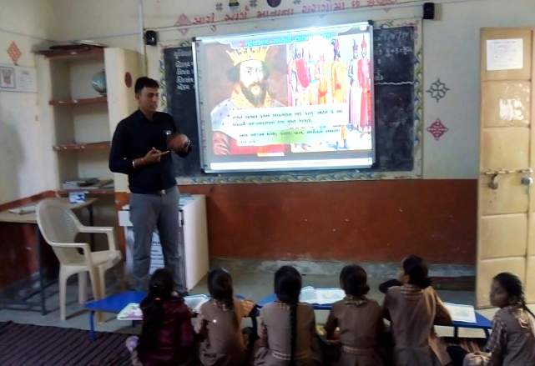
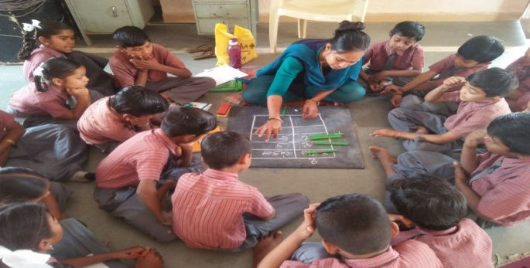
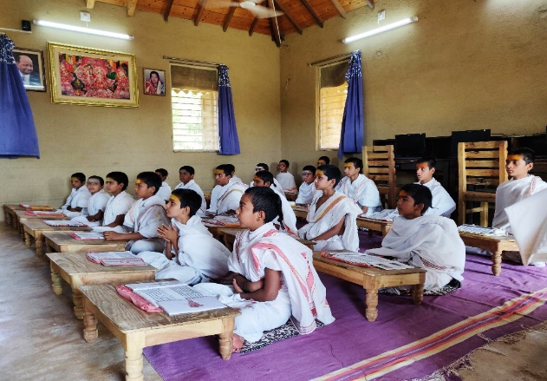
Objective: The project aims at improving learning levels of the students of the government primary schools by merging the interventions of Digital Classroom, Shiksha Saathis (Para Teacher) and Teacher Trainings along with volunteers from the villages to promote education.
Locations: Anjar, Dahej, Vapi and Telangana.
Digital Classrooms
Learning Levels
Teacher Training
Shiksha Saathi
Ved Vidyalaya

Slide 5
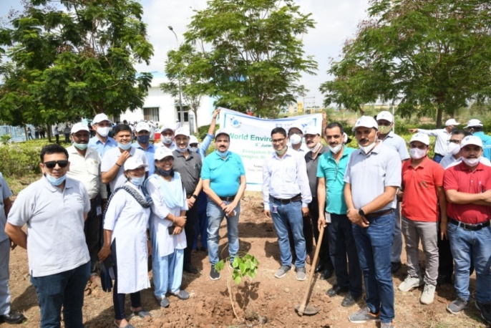
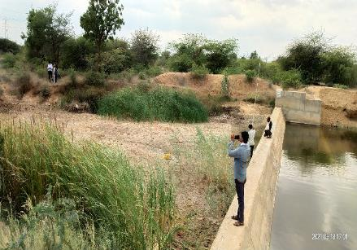
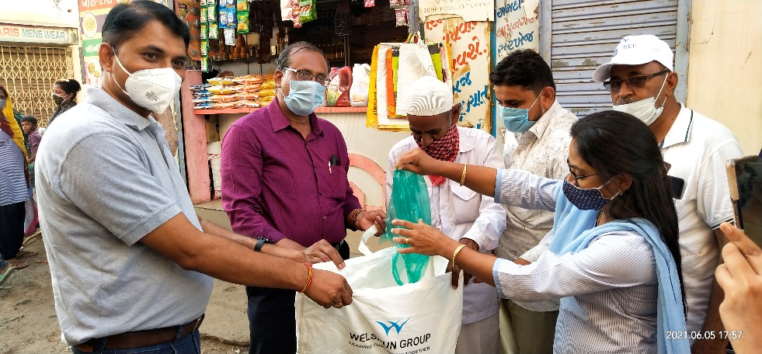
Environmental programs and Tree plantations

Slide 6
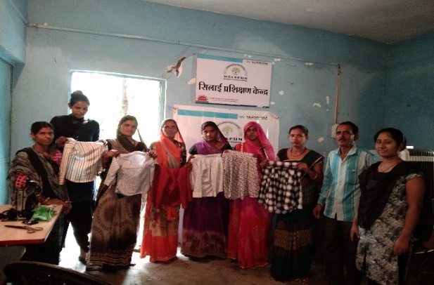
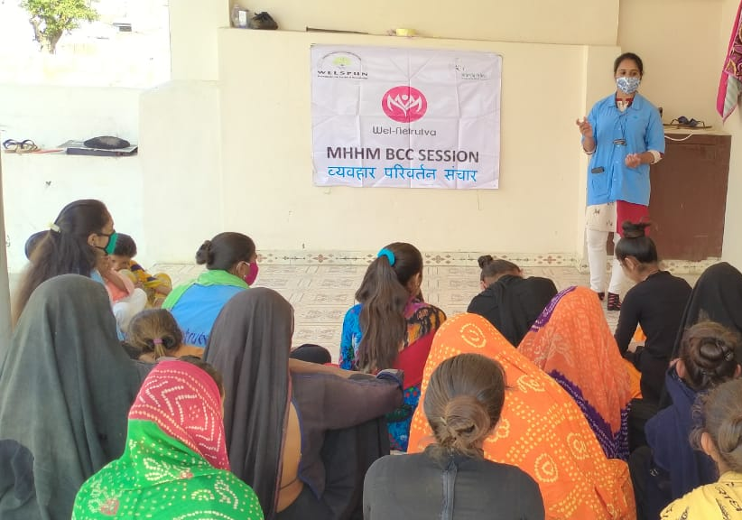
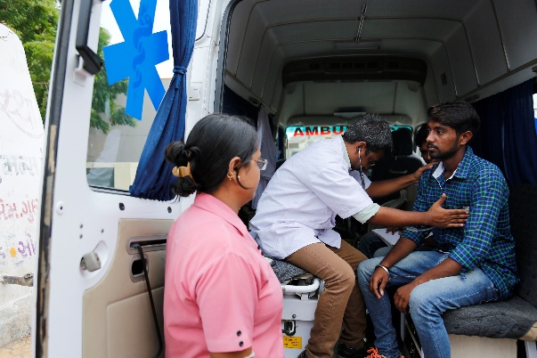
Objective: To empower women in rural areas by improving health practices and creating sustainable livelihood opportunities.
About: Individual and Group Enterprises to create livelihood opportunities. The health aspect of the program focuses on improvement in preventive and curative health aspects of adolescent girls and women.
Locations: Anjar and Vapi.
Livelihood Opportunities
Improved Healthcare
Community Health

Slide 7
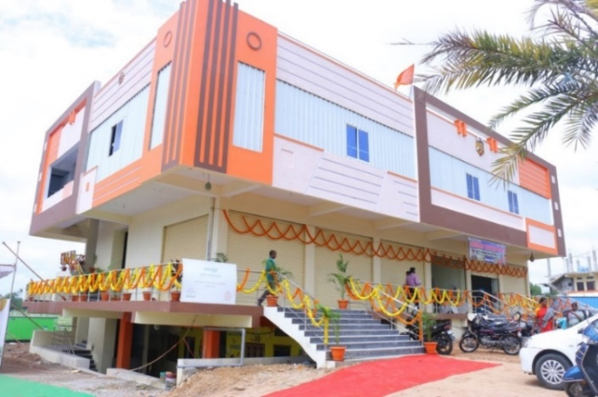
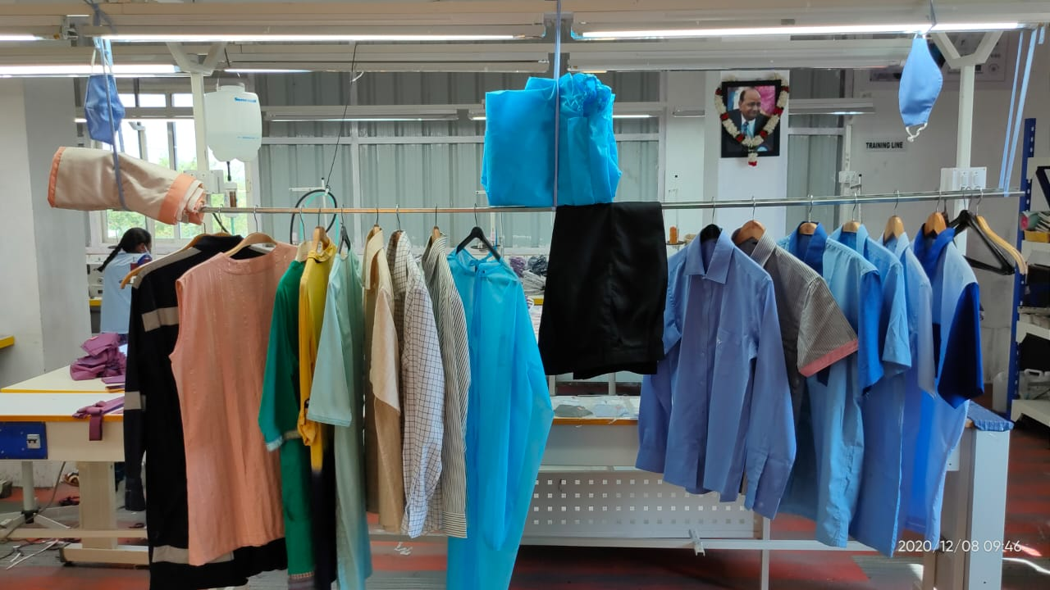
Objective: An all women entrepreneur led manufacturing eco-system aimed at providing women with a sustainable means of livelihood, equitably engage with local and global markets.
Locations: Telangana.
Akankshita Center
Income Generation
Products

Slide 8
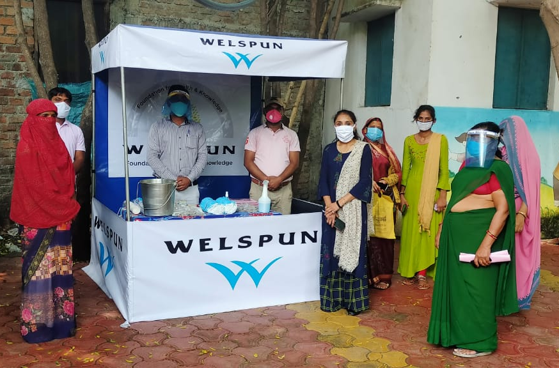
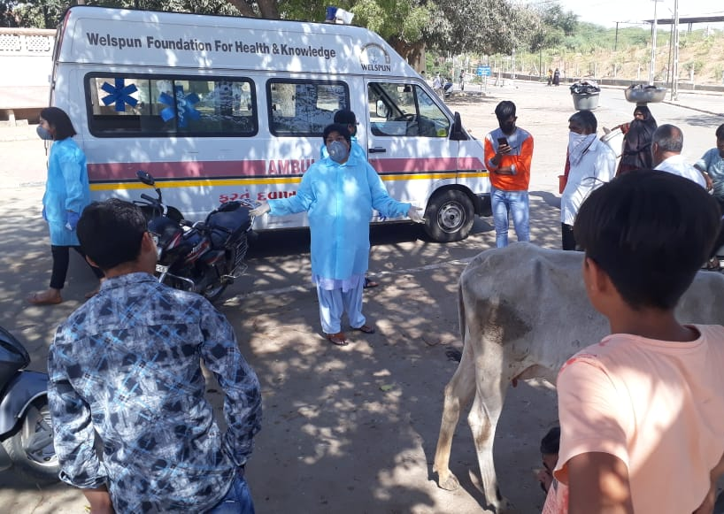
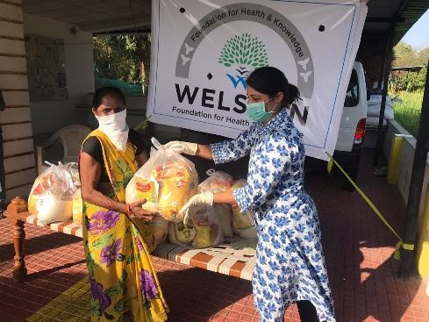
Covid-19 Relief Interventions
Sr. No. | Interventions
1 | Masks
3 | Ration Kits
4 | Ayurveda Tablets
5 | Kadha
6 | Hand Sanitizer Machines
7 | Oxygen Concentrators
8 | Antigen Kits
9 | ICU Ventilators
10 | Village Sanitization
11 | Awareness Drives
12 | Medical Equipment
13 | Oxygen Gas Plant
14 | Vaccinations

